Slide 1


Delray Beach Community Redevelopment Agency
RFP Pre-Submission Meeting
Delray Beach City Hall
100 NW 1st Avenue, Delray Beach
August 29, 2018
2:00 p.m.

Slide 2
West Atlantic Avenue RFP
No Lobbying Provision
This is your only chance to speak directly to CRA staff and ask questions concerning the RFP!!
Observe The Cone of Silence

Slide 3
About Delray Beach
Population over 65,000
  39,000 ages 18-65 (workforce)
  86% of workforce has a high school degree or some higher education
  Median Household Income: $51,829
Central to 2 International Airports, 2 Seaports, and passenger & freight rail lines
Three hospitals (Delray Medical Center, Bethesda Memorial, & Boca Regional)
Two major universities (FAU & Lynn)

Slide 4
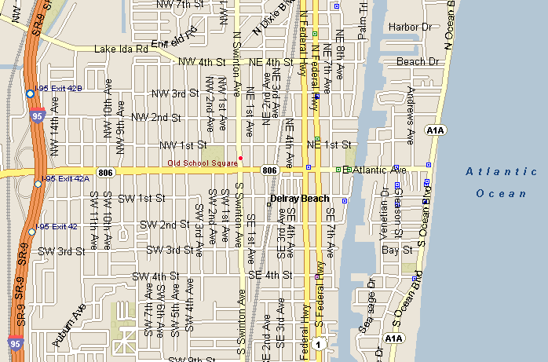
Downtown Delray Beach
West Atlantic Neighborhood
Central Core
Beach District

Slide 5
About West Atlantic Area
“Front Door” to Downtown Delray Beach
From I-95 to Swinton Avenue
Numerous governmental, institutional facilities:
S. County Courthouse, Delray Beach Public Library, Delray Beach Fire Dept. Headquarters, Delray Beach Police Department, Tennis Center (including 8,000 seat Stadium)
Approximately 45,000 vehicular trips per day

Slide 6
CRA Investment in West Atlantic Area and Surrounding Neighborhoods
Redevelopment of the West Atlantic area is a priority, with projects identified in several redevelopment plans:
  Community Redevelopment Plan
  Downtown Master Plan
  Southwest Area Neighborhood Redevelopment Plan
  The Set Transformation Plan (pending adoption)
Other area plans
  Downtown Retail Market Study
  Downtown Shopability Analysis
Since 2003, the CRA has invested over $65 million along W. Atlantic and in the NW/SW neighborhoods

Slide 7
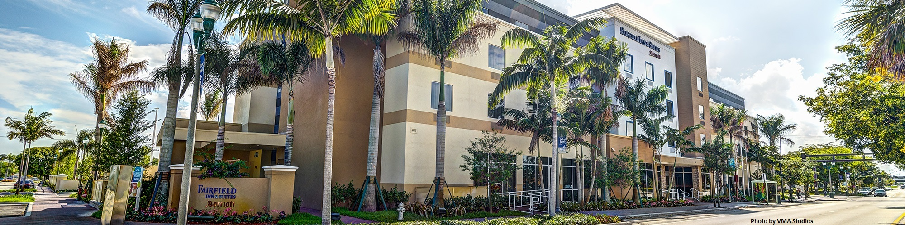
Redevelopment Projects in the Area
Fairfield Inn & Suites by Marriott
910 W Atlantic Ave, Delray Beach

Slide 8
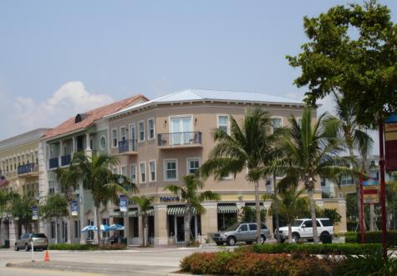
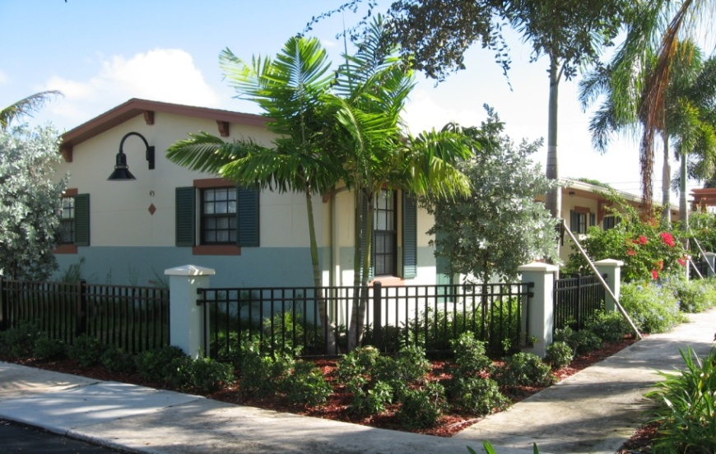
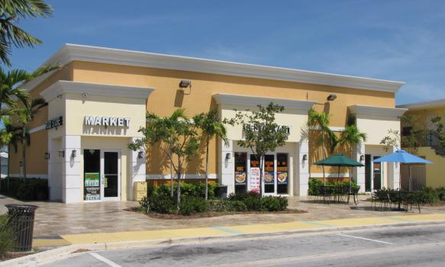
Redevelopment Projects in the Area
Atlantic Grove
Palm Manor Apartments
5th Avenue Market

Slide 9
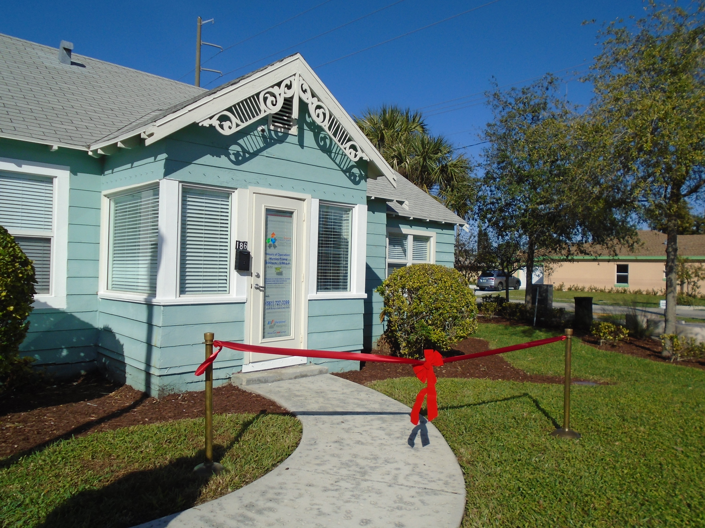
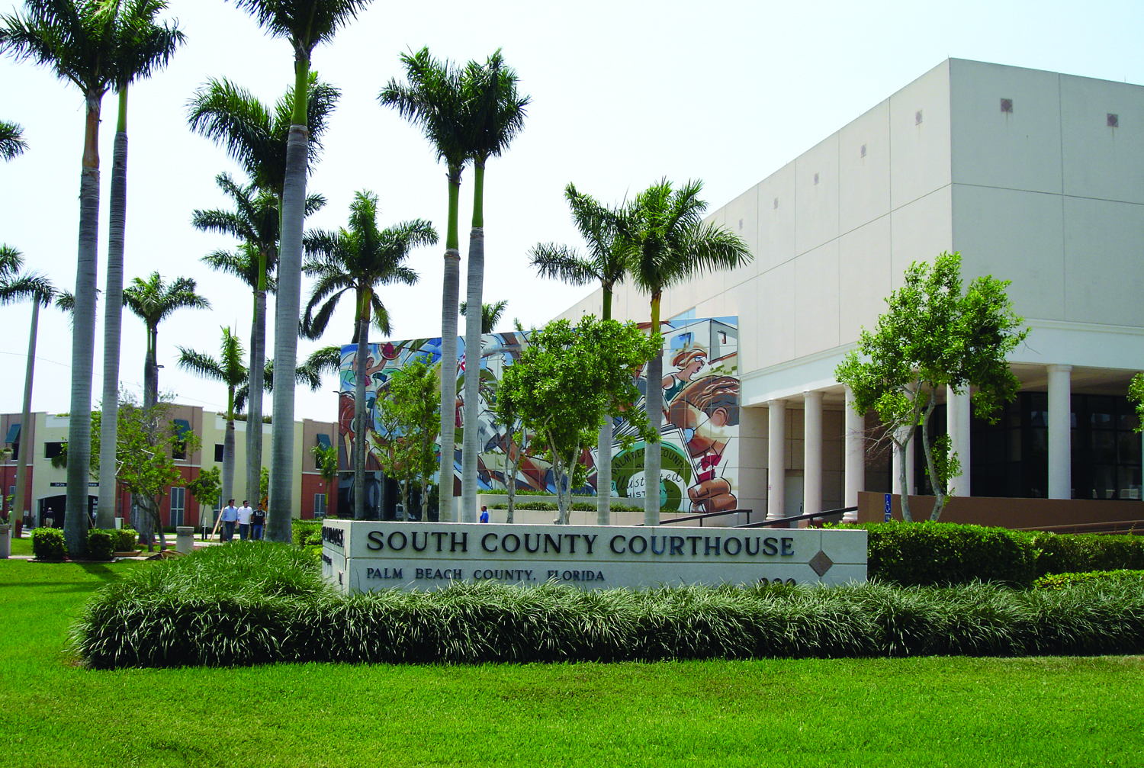
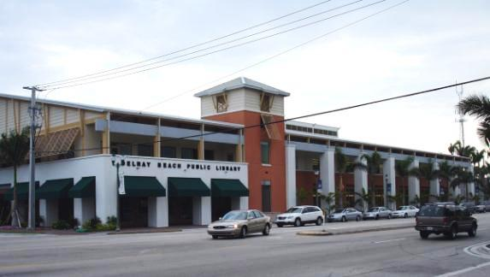
Redevelopment Projects in the Area
Career Cottage
South County Courthouse
Delray Public Library

Slide 10
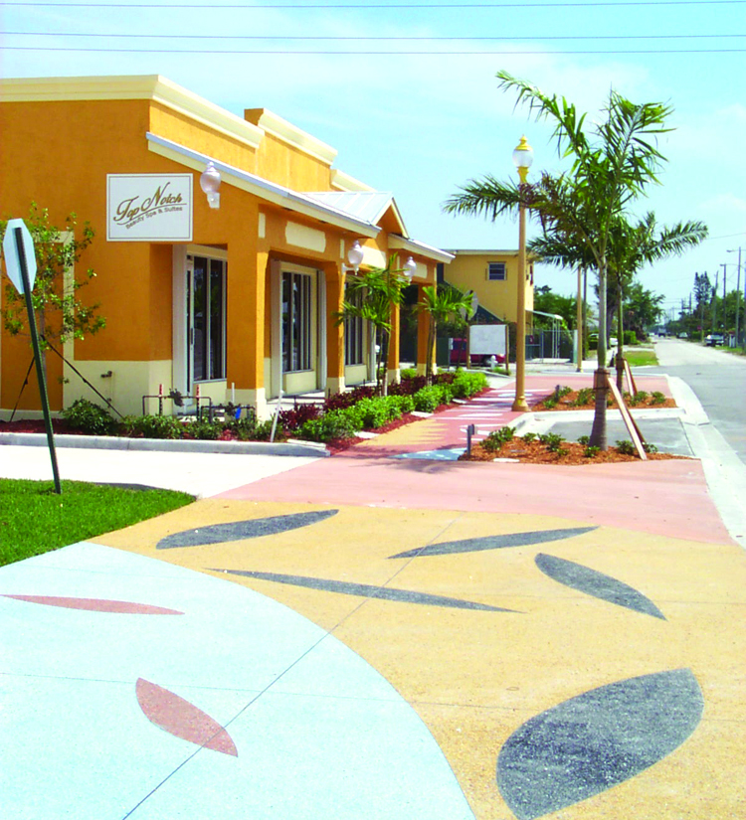
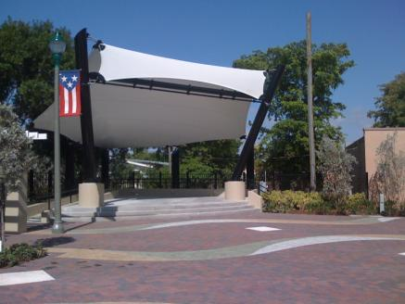
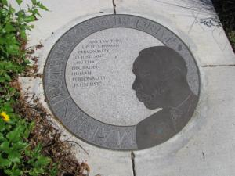
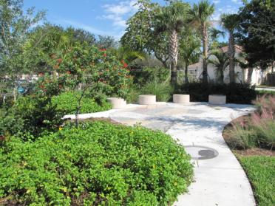
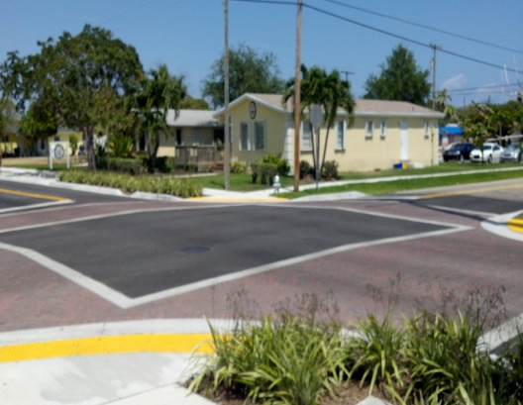
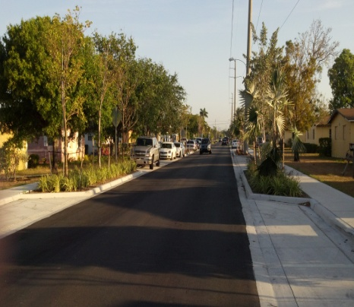
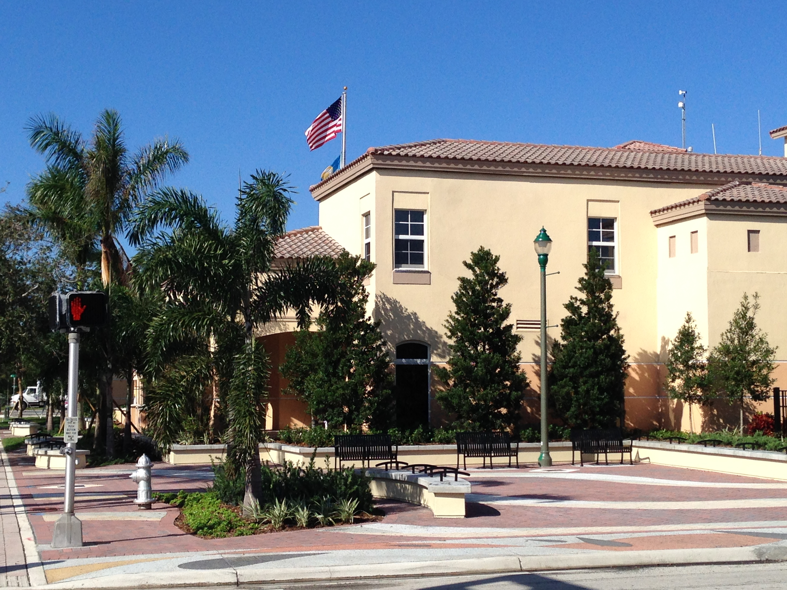
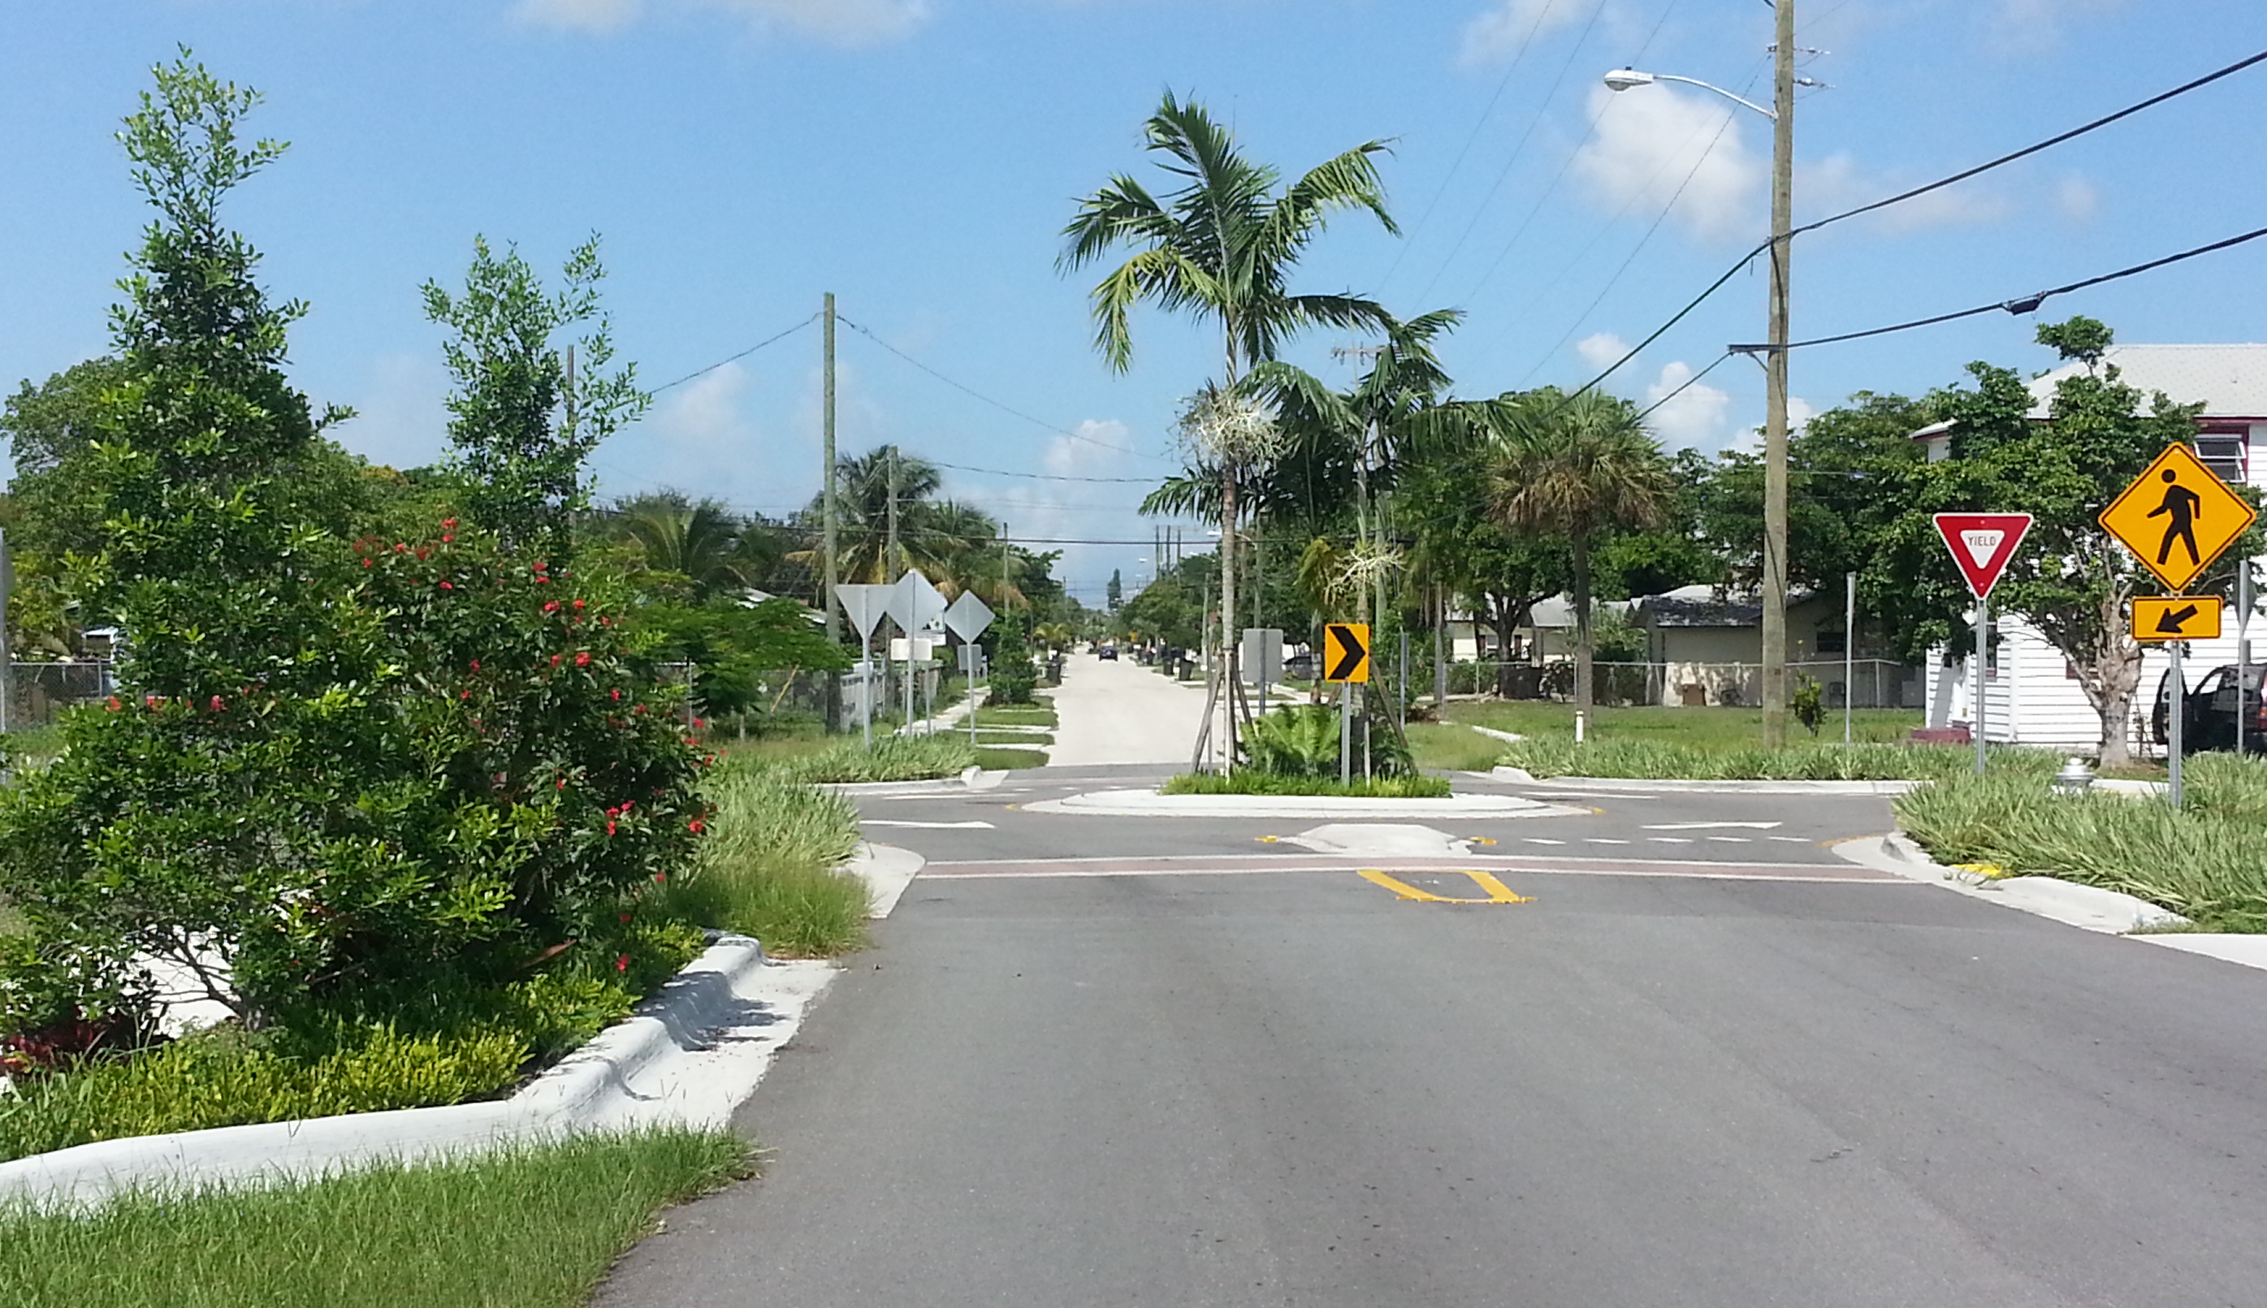
Beautification and Infrastructure
NW/SW 5th Avenue
Libby Wesley Plaza
MLK Jr. Drive Beautification
NW/SW 12th Avenue Beautification
Fire HQ Plaza
SW 2nd St. Beautification

Slide 11
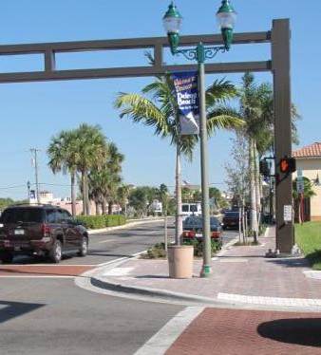
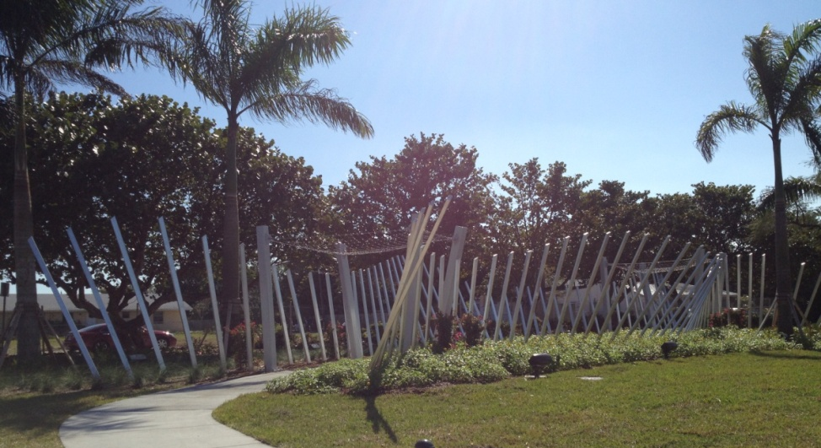
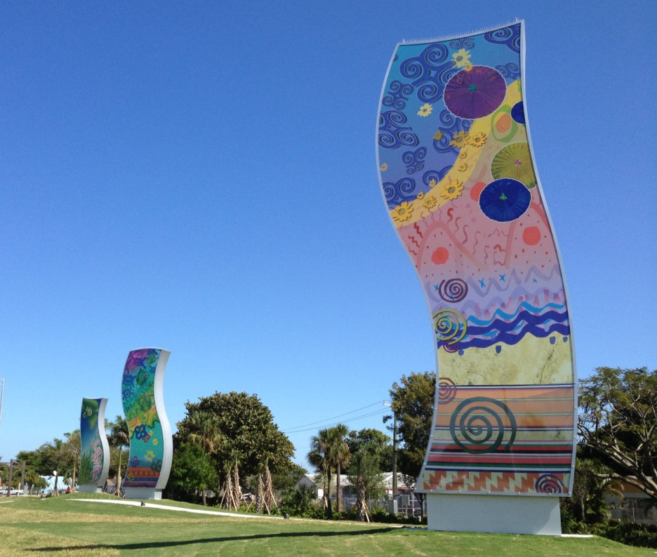
Beautification and Infrastructure
Gateway Feature - I-95 to NW/SW 12th Ave.
West Atlantic Avenue

Slide 12

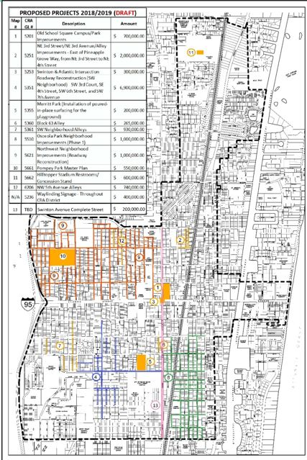
Upcoming Capital
Improvement Projects

Slide 13
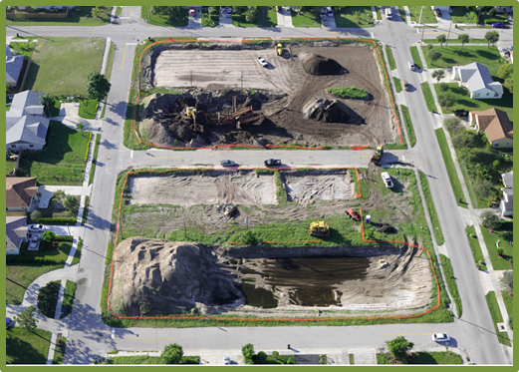
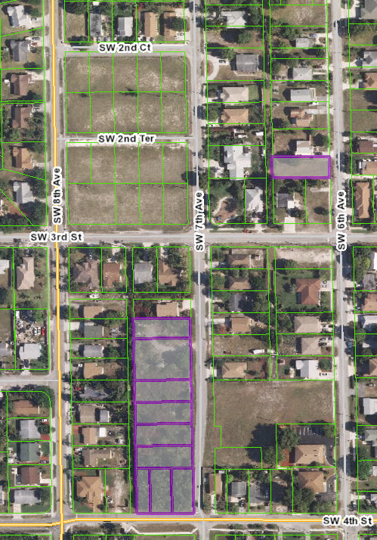
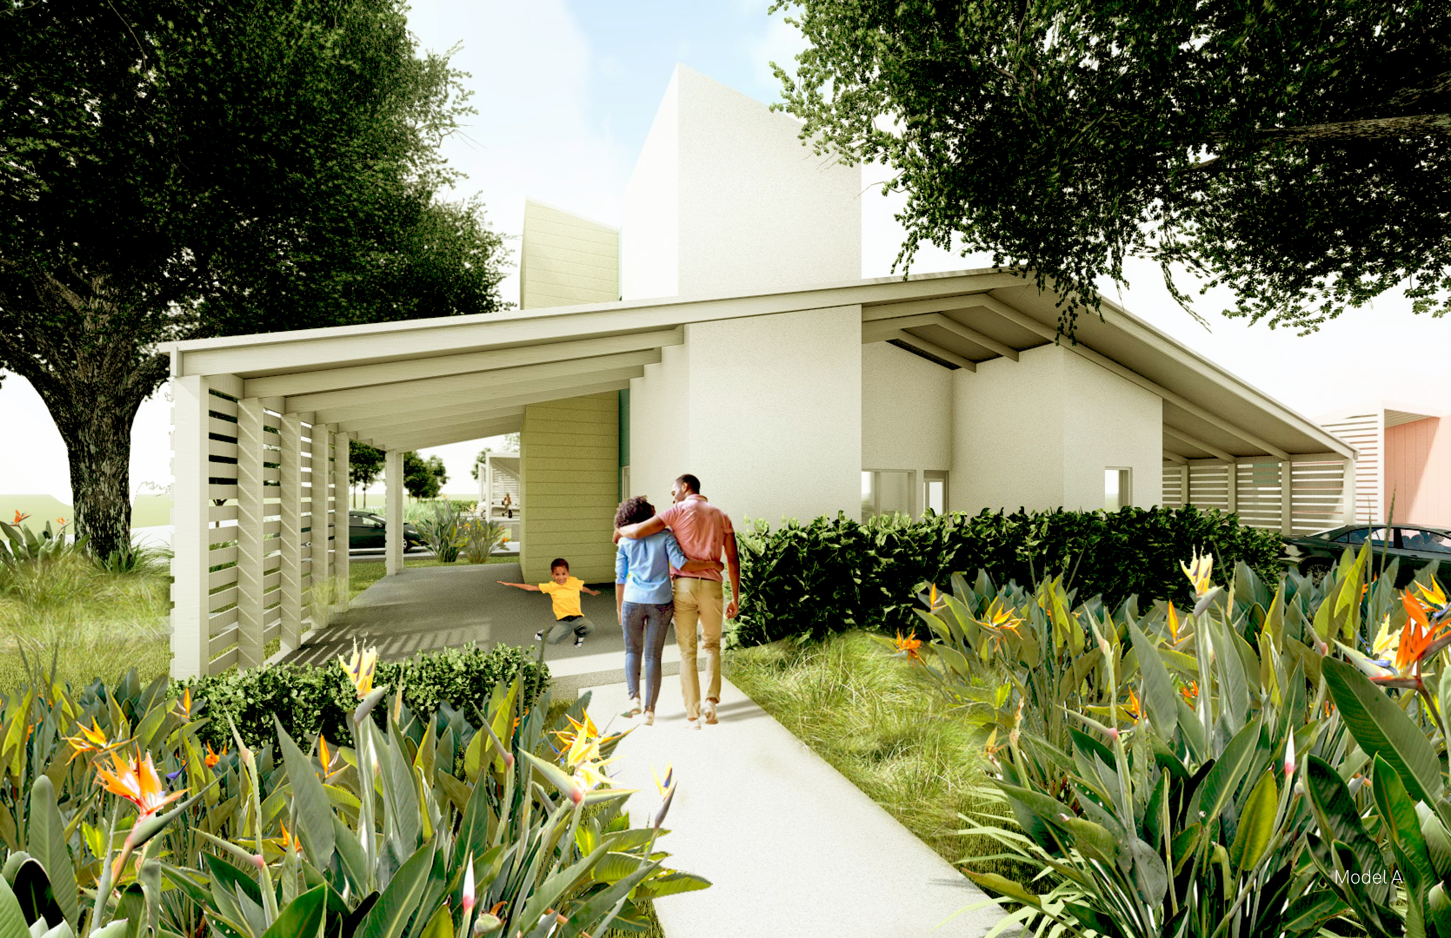
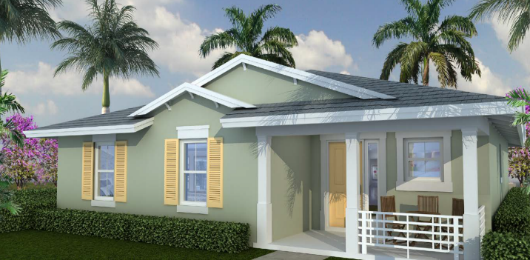
Upcoming CRA Projects
Carver Square Neighborhood Affordable Housing Developments
Carver Square site and northwest corner of SW 7th Avenue and SW 4th Street

Slide 14
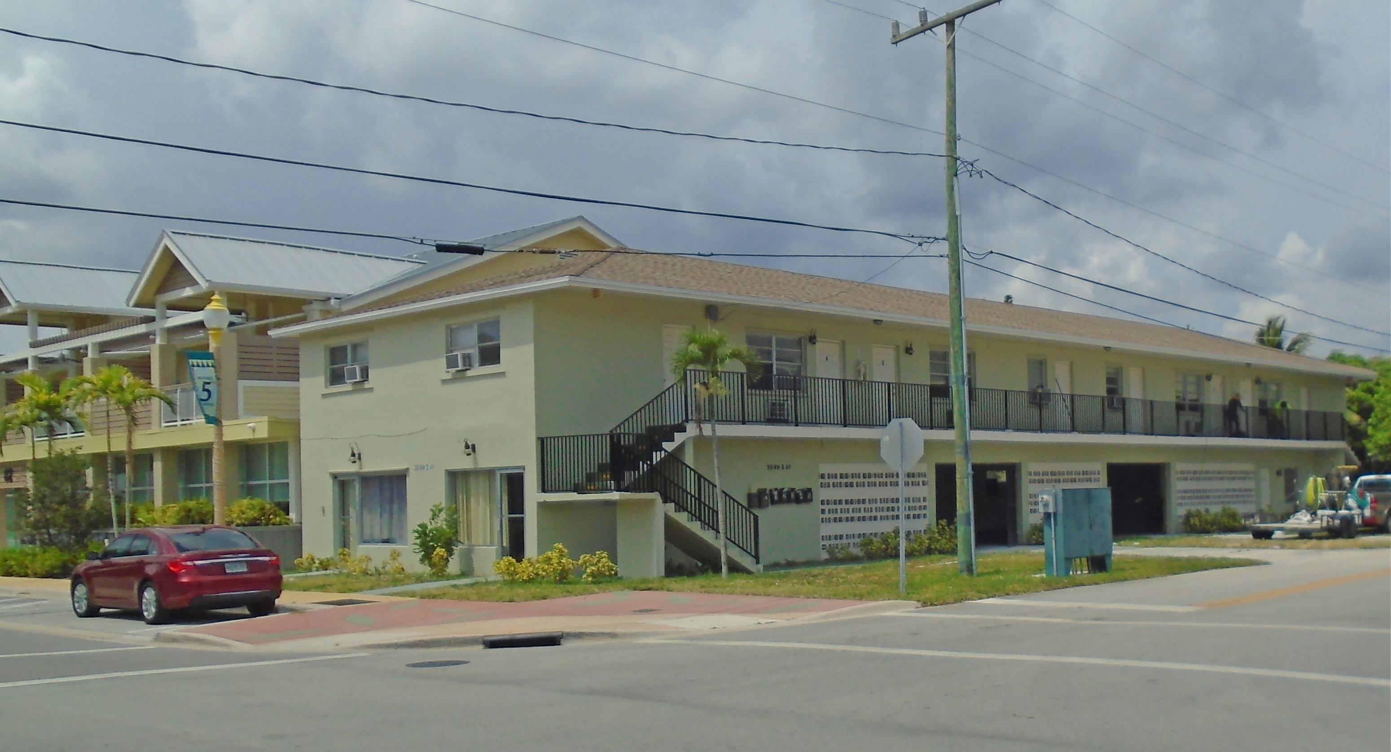
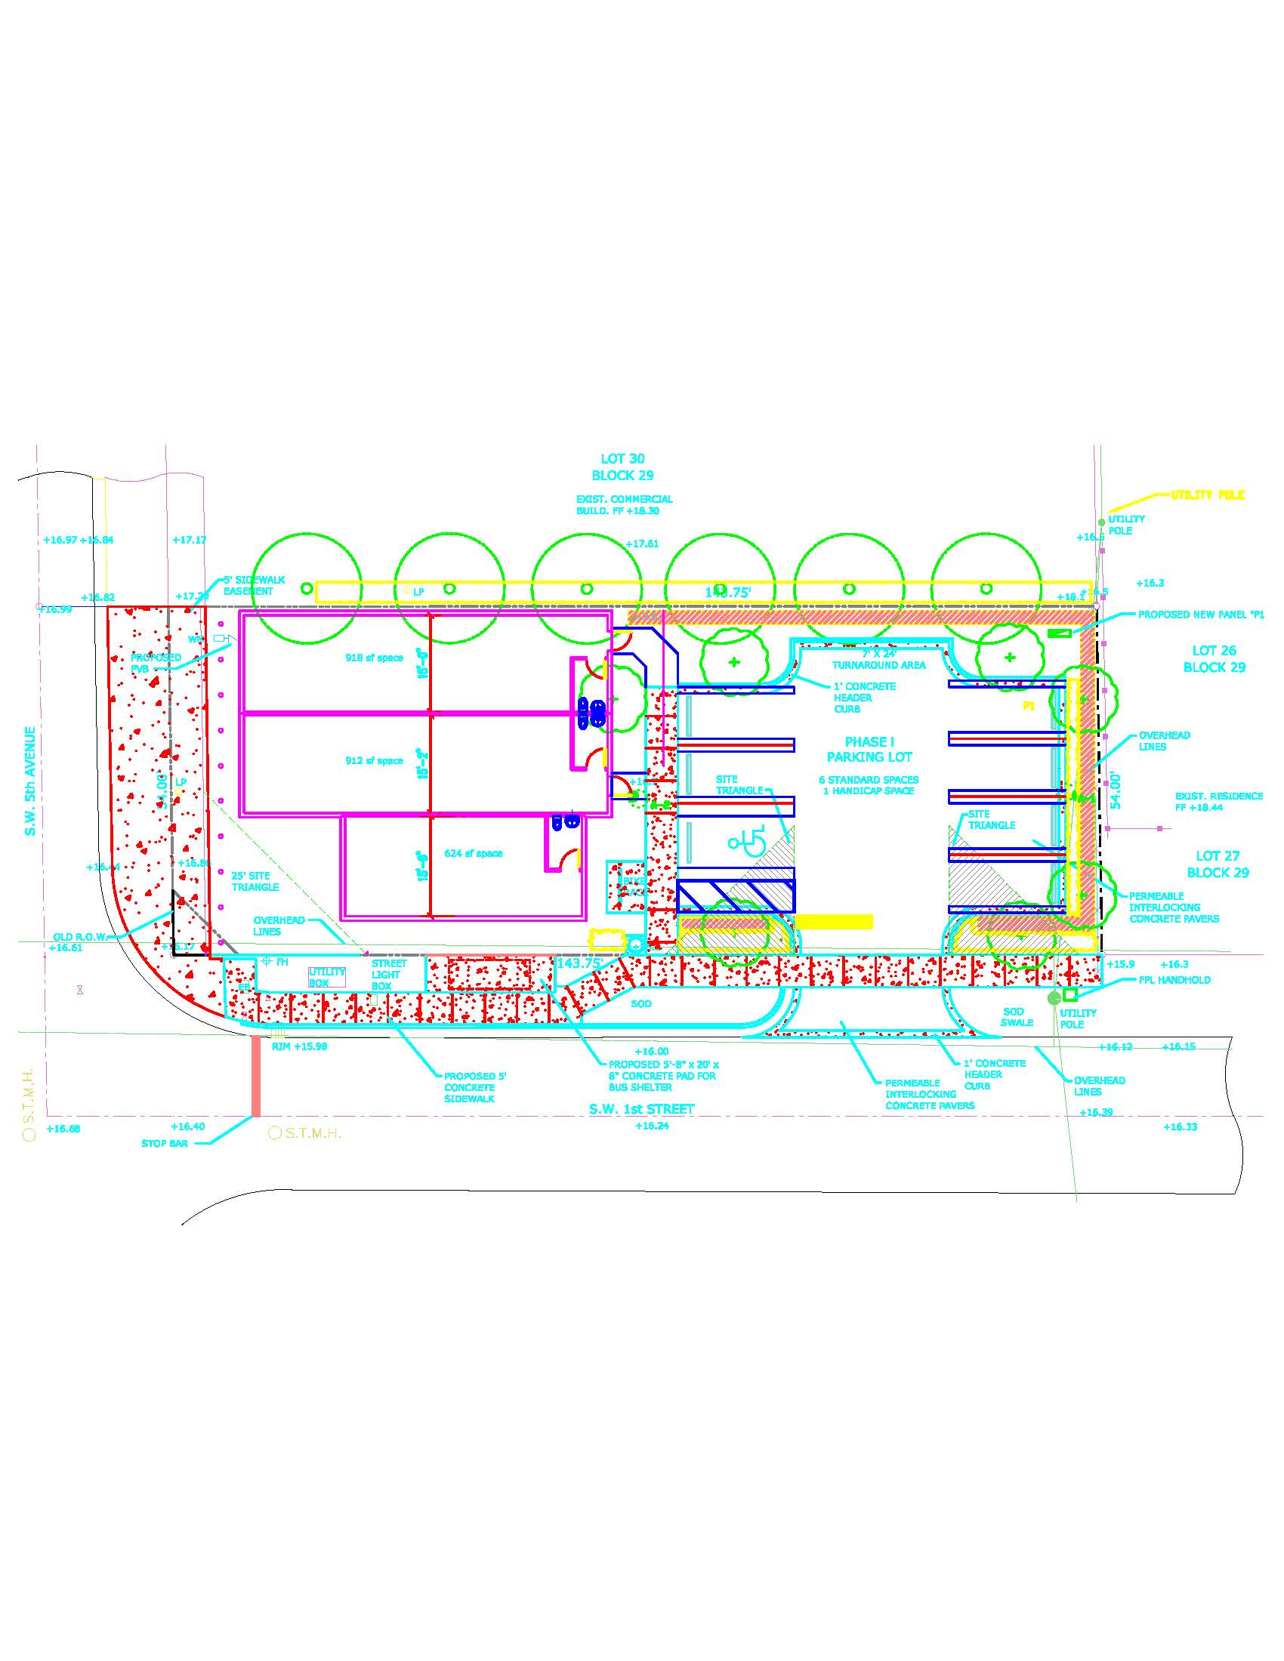
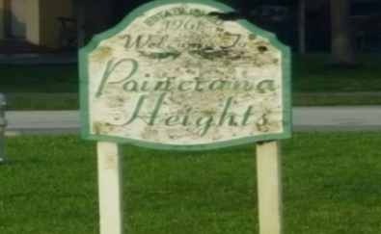
Upcoming CRA Projects
98 NW 5th Ave Mixed-Use Bldg Renovations
SW Corner of NW 5th Avenue & NW 1st Street
  95 SW 5th Avenue Commercial Development
  Between MLK Jr. Drive & SW 1st Street
  NW/SW Neighborhood Identification Signs

Slide 15
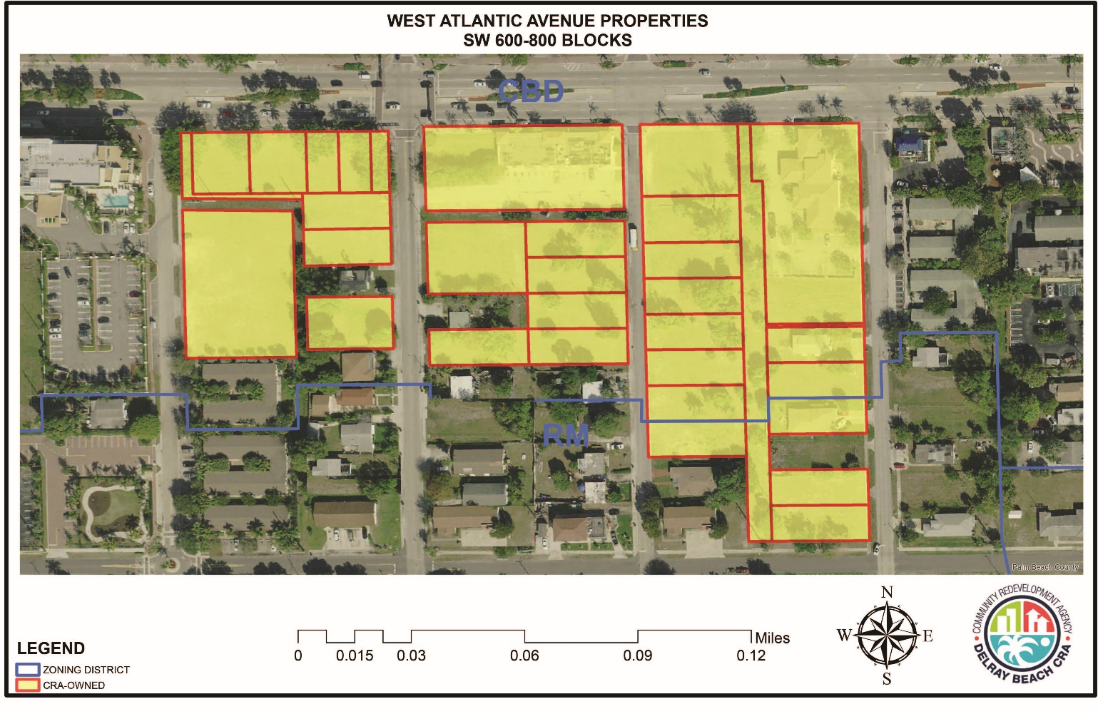
Properties included in RFP

Slide 16
Information about the Properties
  7.4 acres along south side of West Atlantic Ave in 600-700-800 blocks
  CBD zoning allows wide variety of uses
  Approximately 900 feet of frontage on West Atlantic Ave.
  More than 45,000 vehicular trips per day pass the site
  Surveys, appraisal, and environmentals available on CRA website

Slide 17
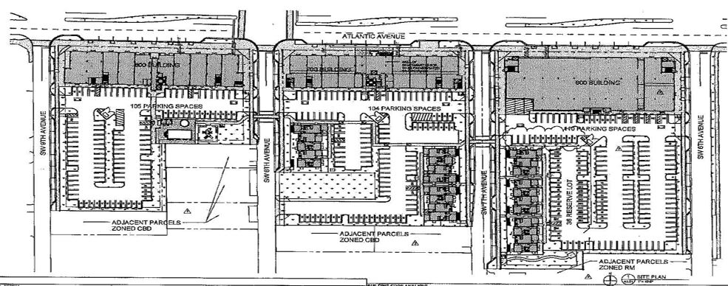
Information about the Properties
  2016 approval of mixed used development consisting of:
    40,264 square feet of commercial/retail space including a grocery store, 7,618 square feet of restaurant space, 20,000 square feet of office space and 112 apartment units, 22 of which is workforce housing

Slide 18
RFP Development Parameters
  Proposal MUST include a full service grocery store that is no less than 20,000 square feet. See RFP page #8 for complete definition.
  Single-phased development preferred
  Wide arcades and sidewalks that promote pedestrian friendliness, open spaces, and activities along Atlantic Avenue are encouraged
  Residential uses are required as part of the mixed use project
  Three-story height limitation (38 Feet)
Buildings to front on Atlantic Avenue with parking, garages, driveways at rear
Opportunities for public/shared parking a plus

Slide 19
Key Elements in RFP
Provision of housing, including workforce housing on-site or off-site
Inclusion of priority uses identified in the 2012 West Atlantic Area Needs Assessment as follows:
  Full-service grocery store (Required use - See RFP page #8 for complete definition)
  Pharmacy*
  Health and wellness facility (urgent care, clinic, fitness center)
  Financial institution (bank or credit union)*
  Family/social entertainment (sports bar, jazz club/lounge, amusement venues)
    *Pharmacy & Financial Institution may be located with the Grocery Store

Slide 20
Key Elements in RFP
Relocation plan for existing businesses (700 W. Atlantic Ave)
Space for local small businesses in the new development
Local hiring and inclusion plan

Slide 21
Local Inclusion & Participation
Award subcontracts to at least six (6) Delray Beach Subcontractors/Vendors within 33444, 33445, and 33483
    Vendors may include suppliers, manufacturers, consulting firms, architects, attorneys, engineers, companies providing surveying or testing, or any other services that are relevant to construction
Construction Management “Teaming” with Local General Contractors
A willingness to work with the CRA and other community partners like the City’s Office of Economic Development, Inc. Pad/SBDC, CareerSource Palm Beach County et al. when seeking local laborers and subcontractors to and support community benefits detailed in the proposal.

Slide 22
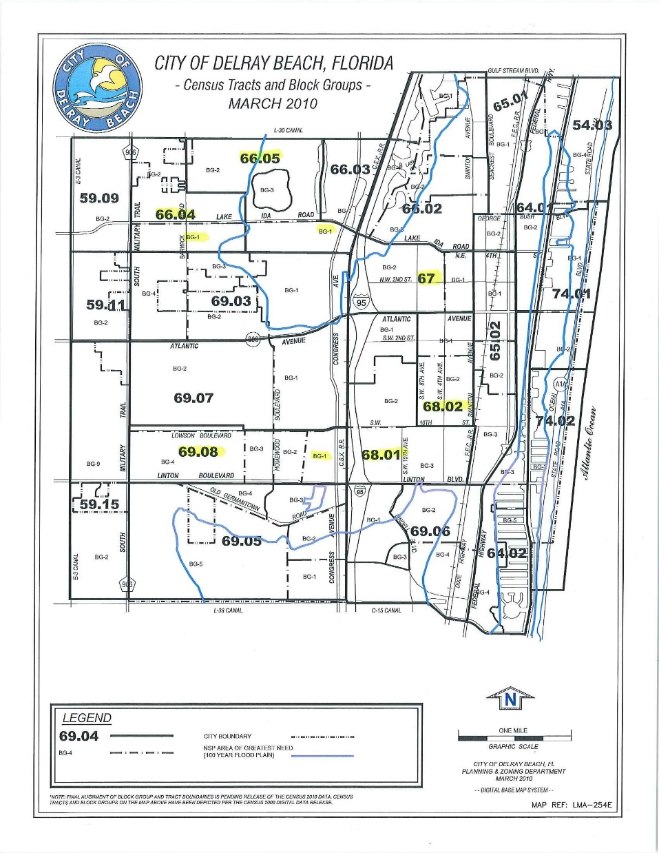
Local Inclusion & Participation
Provide skilled and unskilled construction jobs with at a minimum livable wages for at least 30 (thirty) local persons within certain census tracts

Slide 23
RFP Scoring Criteria
Item | Criteria | Evaluation Criteria
1. | Development Team Experience 20 Points | Clearly demonstrate the experience of the Team and background for developing similar projects.
2. | Project Concept 25 Points | Provides for a mixed-use concept /parking etc. Full-Service Grocer (REQUIRED USE) Inclusion of Priority Uses Design/architectural Size and Scale of project Schedule to deliver project Enhances the City of Delray Beach’s unique identity and sense of place Integrates into neighborhood and emphasizes aesthetic massing and proportion and establishes a strong relationship with the streets
3. | Community Inclusion 20 Points | Tenant Space for Local Businesses (6) Subcontractors commitment (30) Local hires commitment Other (describe)
4. | Financial Structure 20 points | Pro Forma review Sufficient capital Equity commitments Project cash flow projections
5. | Fiscal Impact 15 Points | Provides for the highest or best purchase price or best lease terms Provides new jobs for residents of the city and county Provides a substantial economic impact to the City of Delray Beach

Slide 24
Incentives for Developers
Development Infrastructure Assistance (DIA) (Max. $250,000)
  Partial reimbursement for public infrastructure costs, paid in annual installments over five years after project completion
    Parking with public accessibility
    Sidewalks, lighting, utility upgrades
Land Value Investment (LVI)
  Long-term land lease for CRA-owned property
  $1/year for first 5 years, then incremental rent increases
Job Creation Bonus (JCB)
  For companies relocating or creating at least 5 new higher paying jobs

Slide 25
Delray Beach Opportunity Zone
Opportunity Zones: 3 of Census Tracts – 67, 68.01 and 68.02 primarily known as “The Set” were recently awarded Federal Opportunity Zone status by the U.S. Treasury
Purpose: Opportunity Zones are an economic development tool—that is, they are designed to spur economic development and job creation in distressed communities by providing tax benefits for investors.
Details available on the CRA website: http://delraycra.org/rfp/

Slide 26

RFP Timetable
RFP Issued | August 21, 2018
Pre-Proposal Conference Delray Beach City Hall, First Floor Conference Room, 100 NW 1st Avenue, Delray Beach, FL 33444. (Attendance is on a voluntary basis. PLEASE NOTE: This will be the only opportunity for applicants to directly address CRA staff regarding the RFP.) | August 29, 2018 2:00 pm
Deadline for Questions | September 24, 2018 5:00 pm
RFP Submittal Delray Beach CRA office located at 20 N. Swinton Avenue, Delray Beach, FL 33444. | October 5, 2018 2:00 pm
Selection Committee Ranking | November 6, 2018
Oral Presentations (if required) | November 13, 2018
CRA Board Approval | December 2018

Slide 27
RFP Submittal Requirements
Submission Deadline: October 5, 2018 at 2:00 PM*
  *NOTE: Submission deadline will be discussed at the September 11, 2018 CRA Board Meeting (Detail about meeting on CRA website: http://delraycra.org/meetings-agendas-minutes/)
Location: 20 N. Swinton Avenue, Delray Beach
Refer to Acknowledgment Letter – Checklist – Must be submitted with Proposal
Bid Bond - $25,000.00
Non-refundable application fee - $500.00

Slide 28
Last Chance for Face to Face Questions!!

